Slide 1
TORMA Biztonságtechnika
a presentation by Czéh Szabolcs, Gonda Ákos & Torma Enikő

Slide 2

Teamwork
Czéh Szabolcs – Backend
Gonda Ákos – Database, Documentation
Torma Enikő – Frontend

Slide 3
The Problem
Torma Security Ltd.’s website is outdated.
Customers don’t usually know what they need.
Hard to get an appointment.
No online presence

Slide 4

Our solution
A new modern website with better UX/UI
Configuration system according to customer needs
Online appointment booking
Online shopping oppourtunity which boosts sales

Slide 5
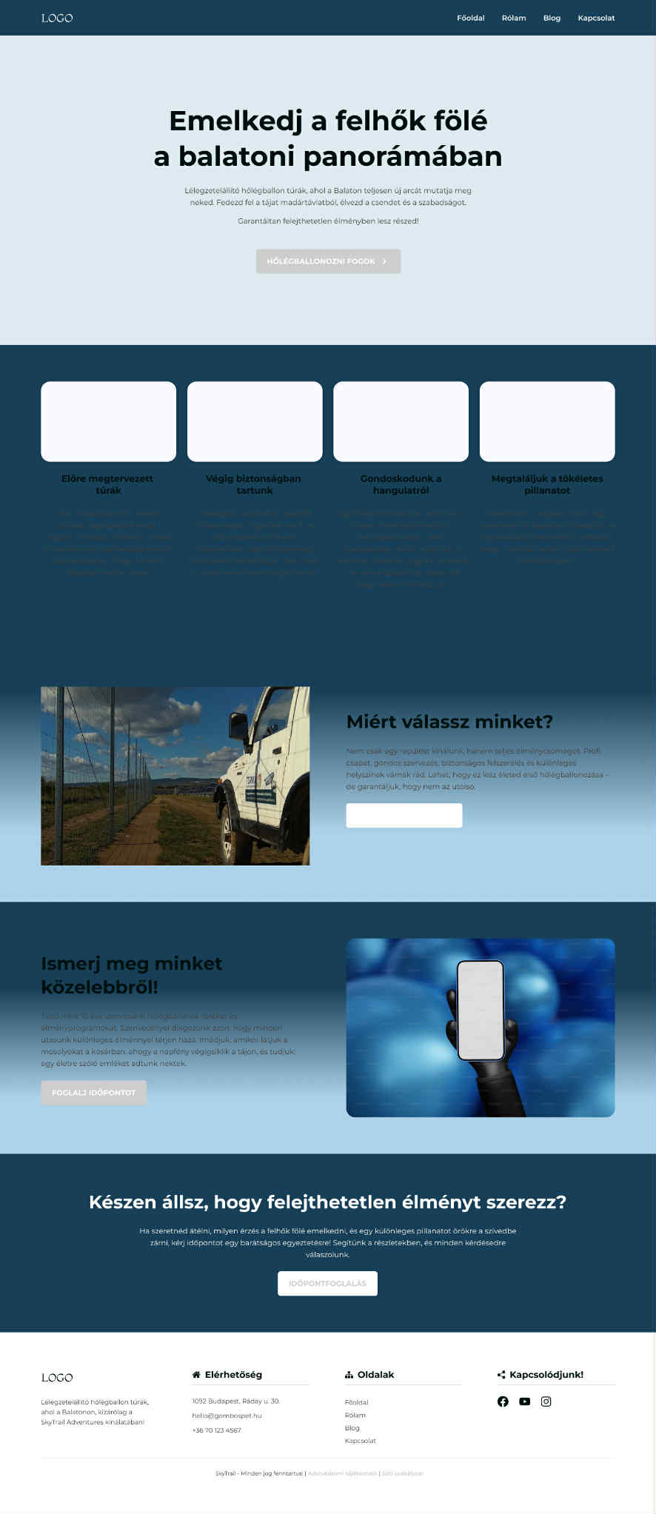
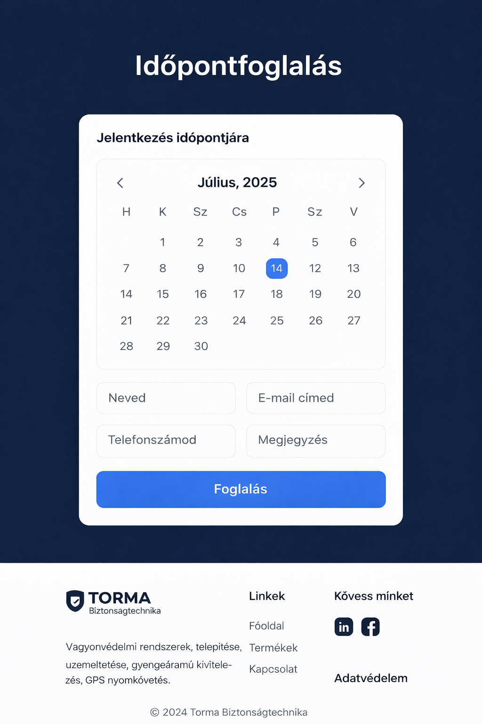
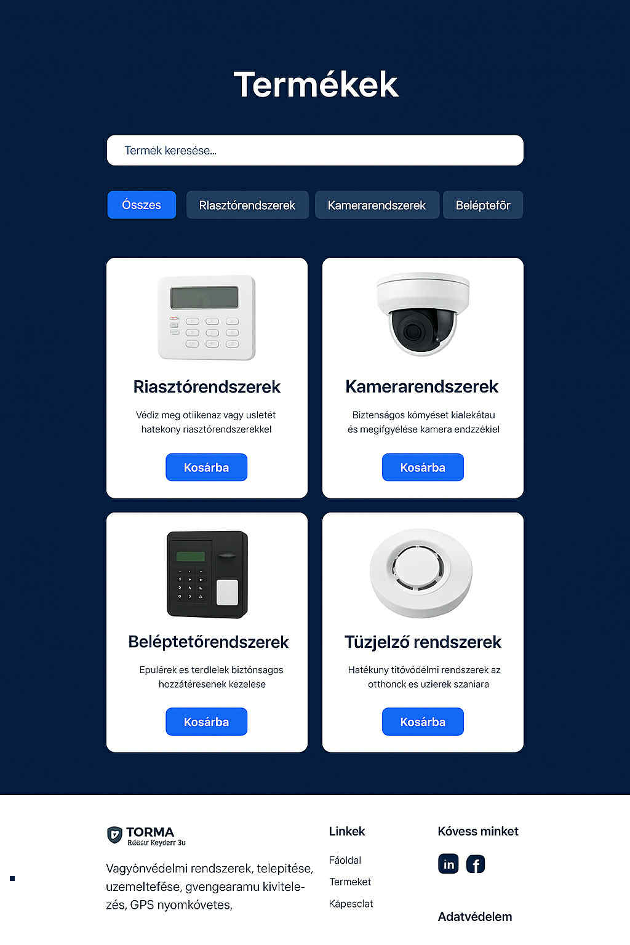
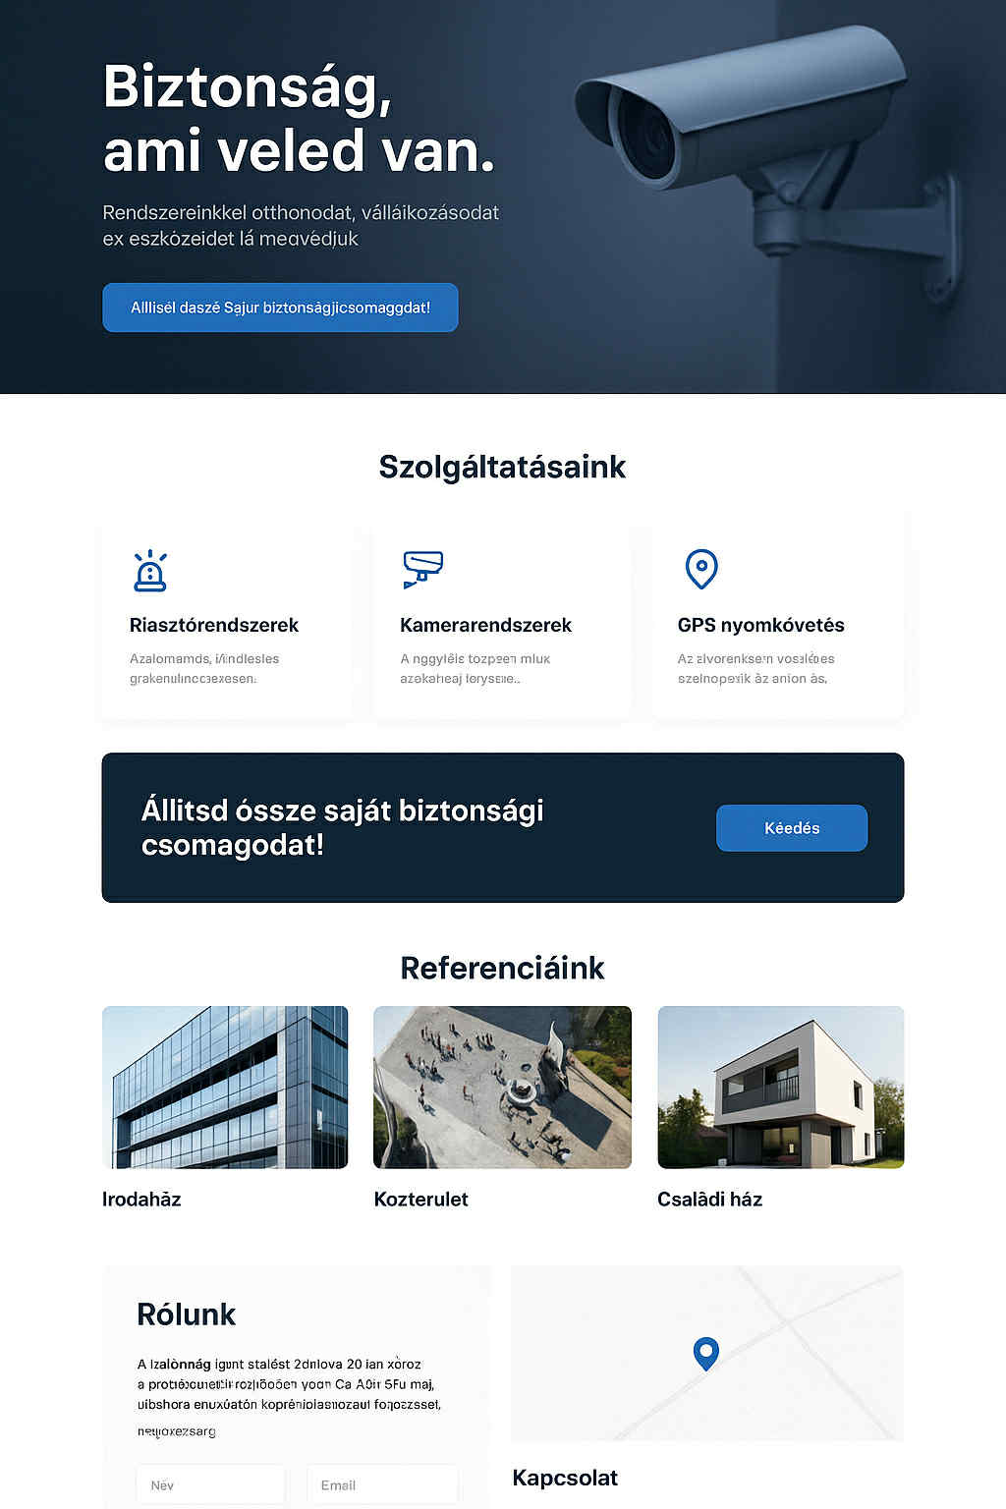
Design plan

Slide 6
Jira & Git - Project management
We are still working on this feature, but the design and concept are already defined.

Slide 7
Technologies used:
Scrum – Trackable deadlines
Jira – Timelines, Task tracking
Git – Version controller
Discord – Team communication

Slide 8
Testing
Testing is planned and will be performed in a later phase of the project.
[Screenshot of the testing documentation will be added here.]

Slide 9
Live design
Live design preview will be added here.
[Live design preview screenshot here]

Slide 10
Future plans
Expand the project with new features and improvements
1
Gather and incorporate user feedback
2
Ensure long term maintenance and update
3
Explore related projects or reserch opportunities
4

